Slide 1
Image Filtering
Concept, Requirement, Types , Tools, Applications
Computer Vision, 6th Semester, 2024

Slide 2
Image Filtering
Enhancing the quality of an image or removing unwanted elements
Usage of masks/window operators to move across the image
Mask coefficients/weights are multiplied with corresponding underlying pixels and the summed result is the output pixel value
Neighbourhood operation (output pixel depends on input pixel and input neighbourhood)

Slide 3
Neighbourhood Operation
Neighborhood under consideration is greater than 1×1 pixel.
Usually 3×3, 5×5, 7×7, etc.
Even-sized neighbourhood not considered (difficult to allocate central pixel)
Instead of acting on a single pixel, the transformation function acts over the neighbourhood of the pixel under consideration
The transformation function is in the form of a mask.
Mask value shows what kind of enhancement is going to be achieved.

Slide 4
Neighbourhood Operation
3 × 3 Neighbourhood of a pixel (X, Y) and the Mask
(X, Y)
Y
W_{-1,-1} | W_{-1,0} | W_{-1,1}
W_{0,-1} | W_{0,0} | W_{0,1}
W_{1,-1} | W_{0,1} | W_{1,1}
X
3×3 MASK
Mathematically, the enhance image can be written as

Slide 5
Requirement
Image Enhancement
Image Restoration
Noise Removal
Edge Highlighting
Feature Extraction

Slide 6
Types
Statistical
Mean/average
Simple
Weighted
Gaussian
Minimum and Maximum
Midpoint
Median
Edge Detectors (Prewitt, Sobel, Canny, LoG, etc.)
Pass-based
Low-pass
High-pass (and High-Boost)
Band-pass
Band-reject
Smoothening/Smoothing filters
Sharpening filters
Convolutional Filter Kernels (used in Convolutional Neural Networks)

Slide 7
Statistical filters

Slide 8
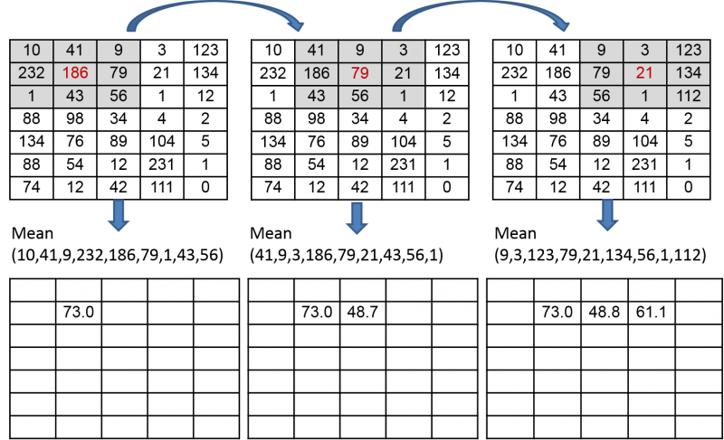
Mean Filter
A simple and effective smoothing technique used to reduce noise and blur in digital images.
Replace each pixel's intensity with the average value of its neighboring pixels, often within a predefined window or kernel.
Effective for noise reduction
Can result in loss of image details and may not be suitable for preserving sharp edges in certain applications.
Types of means:
Arithmetic Mean
Geometric Mean
Harmonic Mean

Slide 9
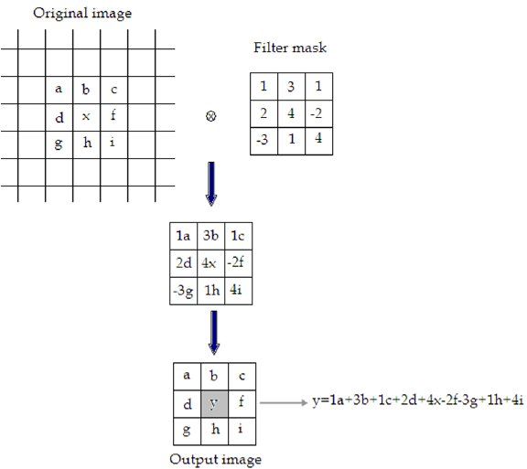
Weighted Mean Filtering
Weighted mean filtering assigns different weights to neighboring pixels
Emphasize the contributions of certain pixels more than others in the averaging process.
More flexibility
Selective preservation of image details and improved handling of non-uniform noise.
The choice between linear and weighted mean filtering is task-dependent:
Linear mean filters – simpler
Weighted mean filters – more nuanced control over the smoothing process.

Slide 10
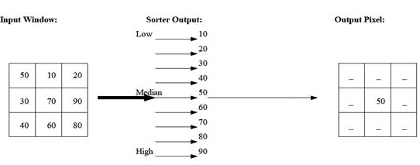
Median Filter
Non-linear technique commonly used for noise reduction.
Replace each pixel's intensity with the median value of its neighboring pixels within a defined window.
Effective in preserving sharp edges and details
Suitable for images with salt-and-pepper noise.
Robust in handling outliers
Reliable means of enhancing image quality.
Reduces the impact of sporadic noise without blurring the overall image.

Slide 11
Minimum and Maximum Filters
Non-linear operations designed to enhance or suppress certain features within an image.
Minimum filter:
Replace each pixel's intensity with the minimum value within a specified neighborhood
Effectively emphasize darker regions
Minimizing the impact of bright outliers (salt noise)
Maximum filter:
Replace each pixel with the maximum value in a specified neighborhood
Highlighting brighter areas
Suppress darker elements (pepper noise)
Application:
Image contrast enhancement
Edge detection
Noise reduction
Valuable tools for adjusting the perceptual qualities of images based on specific requirements

Slide 12
Midpoint Filter
Non-linear technique used for noise reduction.
Replace each pixel's intensity with the midpoint between the minimum and maximum values within a defined neighborhood.
Effective in balancing the contrast while preserving both dark and bright features in an image.
Particularly useful for images affected by salt-and-pepper noise
Compromise between mean and extreme value filtering methods.

Slide 13
Smoothing filters

Slide 14
Various Smoothing Filters
Mean Filter
Gaussian Filter
Applies a weighted average to pixels with emphasis on the central pixel, creating a smoothing effect based on a Gaussian distribution.
Median Filter
Bilateral Filter
Considers both spatial and intensity differences, smoothing the image while preserving edges by combining weighted averages.
Box Filter
Similar to the mean filter, but uses equal weights for all pixels in the neighborhood, providing a simple form of smoothing.
Wiener Filter
Utilizes statistical information to perform adaptive filtering, adjusting the filter based on the local characteristics of the image and noise.
Anisotropic Diffusion
Iteratively smooths an image while preserving edges by diffusing intensity variations in a direction-dependent manner.

Slide 15
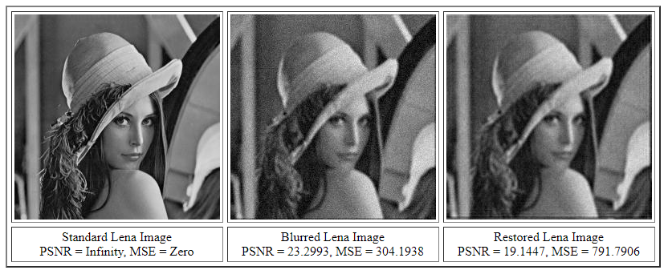
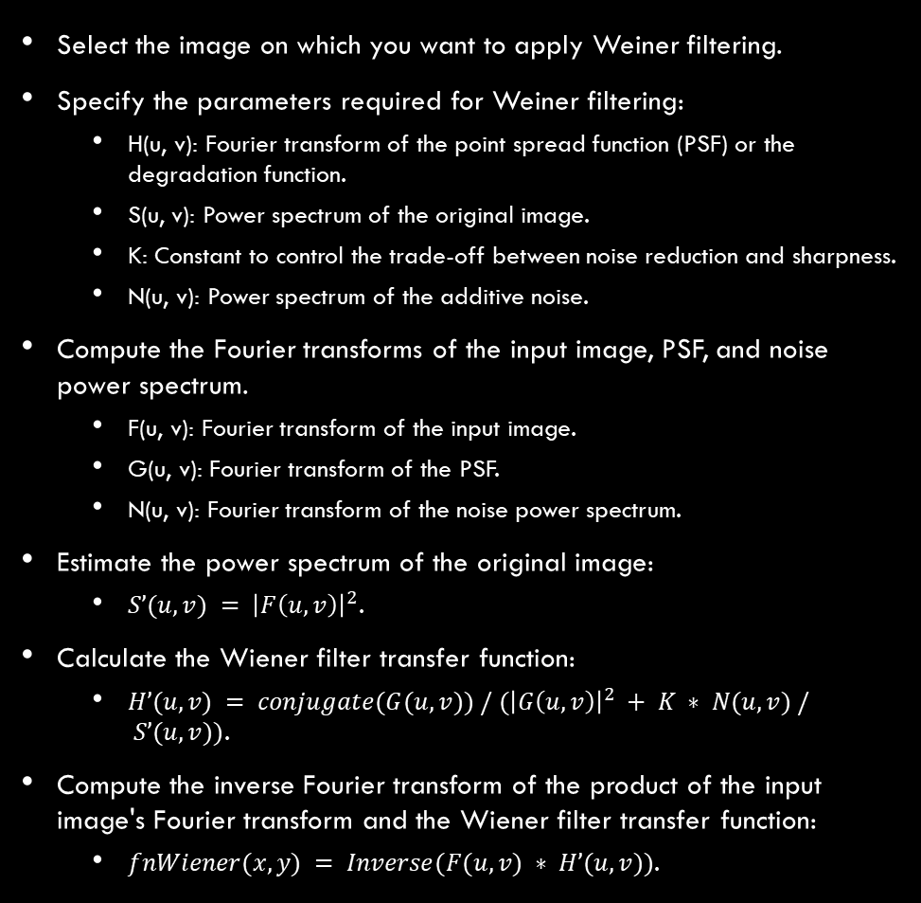
Wiener Filter
Select the image on which you want to apply Weiner filtering.
Specify the parameters required for Weiner filtering:
H(u, v): Fourier transform of the point spread function (PSF) or the degradation function.
S(u, v): Power spectrum of the original image.
K: Constant to control the trade-off between noise reduction and sharpness.
N(u, v): Power spectrum of the additive noise.
Compute the Fourier transforms of the input image, PSF, and noise power spectrum.
F(u, v): Fourier transform of the input image.
G(u, v): Fourier transform of the PSF.
N(u, v): Fourier transform of the noise power spectrum.
Estimate the power spectrum of the original image:
$S’(u, v) = {\left|F\left(u, v\right)\right|}^{2}$.
Calculate the Wiener filter transfer function:
$H’(u, v) = conjugate(G(u, v)) / ({\left|G\left(u, v\right)\right|}^{2} + K ∗ N(u, v) / S’(u, v))$.
Compute the inverse Fourier transform of the product of the input image's Fourier transform and the Wiener filter transfer function:
$fnWiener(x, y) = Inverse(F(u, v) ∗ H’(u, v))$.

Slide 16
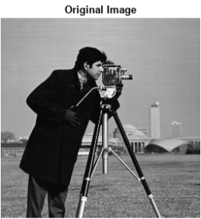
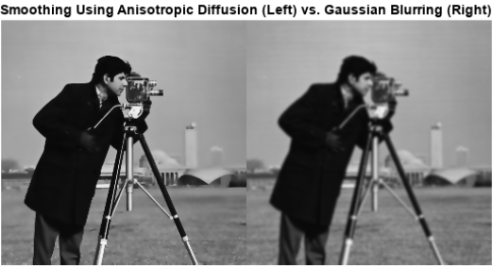
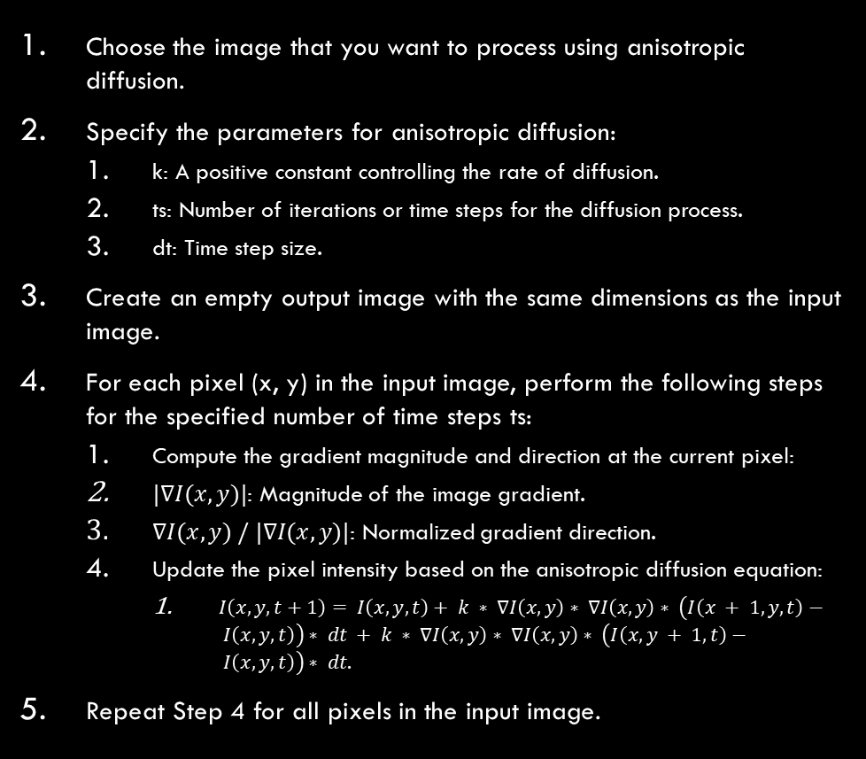
Anisotropic Diffusion
Choose the image that you want to process using anisotropic diffusion.
Specify the parameters for anisotropic diffusion:
k: A positive constant controlling the rate of diffusion.
ts: Number of iterations or time steps for the diffusion process.
dt: Time step size.
Create an empty output image with the same dimensions as the input image.
For each pixel (x, y) in the input image, perform the following steps for the specified number of time steps ts:
Compute the gradient magnitude and direction at the current pixel:
$|∇I(x, y)|$: Magnitude of the image gradient.
$∇I(x, y) / |∇I(x, y)|$: Normalized gradient direction.
Update the pixel intensity based on the anisotropic diffusion equation:
$I\left(x, y, t+1\right)= I\left(x, y, t\right)+ k ∗ ∇I\left(x, y\right)∗ ∇I\left(x, y\right)∗ \left(I\left(x + 1, y, t\right)− I\left(x, y, t\right)\right)∗ dt + k ∗ ∇I\left(x, y\right)∗ ∇I\left(x, y\right)∗ \left(I\left(x, y + 1, t\right)− I\left(x, y, t\right)\right)∗ dt$.
Repeat Step 4 for all pixels in the input image.

Slide 17
Sharpening filters

Slide 18
Various sharpening filters
Laplacian filter and Marr-Hildreth (LoG - Laplacian of Gaussian) filter
Edge Filters (Sobel, Prewitt, Canny, etc.)
Unsharp Masking
Involves subtracting a blurred version of the image from the original to enhance fine details while reducing noise.
High Boost Filtering
A modification of unsharp masking, which combines the original image with a weighted high-pass filtered version to enhance edges and details.
Gradient Filters (Roberts, Kirsch, Robinson Compass, etc.)
Edge Enhancement by Histogram Equalization:
Enhances local contrast and edges by redistributing pixel intensities using histogram equalization.

Slide 19

Unsharp Masking
Select the image on which you want to apply unsharp masking.
Use Gaussian smoothing filter to blur the image.
Degree of smoothing: determined by standard deviation of the Gaussian kernel.
Subtract the blurred image from the original to create a high-pass filter or "mask."
It highlights edges and details by emphasizing the pixel value differences.
Multiply the mask by a factor to control the enhancement strength.
Fine-tune the amount of sharpening applied to the image.
Add the adjusted mask to the original image to produce the final sharpened result.
Enhance edges and details in the image
Preserve overall contrast.

Slide 20
Pass-based filters

Slide 21
Low-pass Filter
Choose the image that you want to apply the low-pass filter to.
Choose a low-pass filter kernel, such as a Gaussian filter or a simple box filter.
Kernel size => Extent of smoothing.
Convolve the input image with the selected low-pass filter kernel.
Compute the weighted average of pixel values within the filter kernel window for each pixel in the image.

Slide 22
High-pass Filter
Choose the image that you want to process using a high-pass filter.
Choose a low-pass filter kernel, such as a Gaussian filter or a simple box filter.
Kernel size => Extent of smoothing.
Convolve the input image with the selected low-pass filter kernel.
Compute the weighted average of pixel values within the filter kernel window for each pixel in the image.
Subtract the low-pass filtered image from the original image.
Result:
High-pass filter or mask
Highlights high-frequency components.
Add the high-pass filter to the original image to produce the final high-pass filtered result.

Slide 23
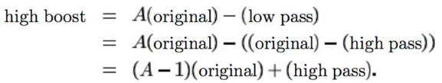
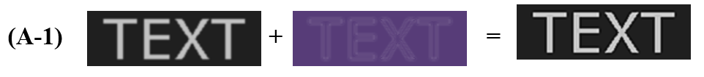
High-Boost Filtering
Choose the image on which you want to apply high-boost filtering.
Blur the input image with a low-pass filter.
Removes high-frequency details.
Retains low-frequency components.
Subtract the low-pass filtered image from the original image to obtain a high-boost mask.
Emphasize high-frequency components.
Represent the edges and details in the image.
Multiply the high-boost mask by a factor to control the enhancement strength.
Fine-tune the amount of detail enhancement.
Add the adjusted high-boost mask to the original image to produce the final high-boost filtered result.
Enhance edges and details.
Suppress low-frequency components.

Slide 24
Band-pass Filter
Choose the image that you want to process using a band-pass filter.
Choose or design a low-pass filter kernel and a high-pass filter kernel.
Low-pass filter suppresses high-frequency components.
High-pass filter suppresses low-frequency components.
Convolve the input image with the low-pass filter kernel.
Convolve the input image with the high-pass filter kernel.
Subtract the low-pass filtered image from the high-pass filtered image.
Result:
Band-pass filter or mask
Retains frequencies within a specific range.
Optionally, amplify or adjust the band-pass filter values by multiplying by a constant or scaling factor, to control the strength of the band-pass enhancement.
Add the adjusted band-pass filter to the original image to produce the final band-pass filtered result.

Slide 25
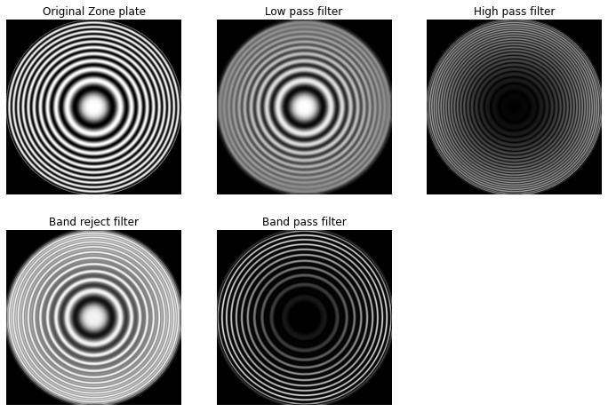
Pass Filters – Example

Slide 26
Convolutional filter Kernels
Used in Convolutional Neural Networks (CNN)

Slide 27
CNN Kernels
Key Aspects:
Feature Extraction:
CNN filter kernels: small-sized matrices used for feature extraction from input data through convolutional operations.
Learnable Parameters:
Filter kernel values: learnable parameters optimized by the CNN during training, adjusted to capture important features from the input data.
Spatial Hierarchies:
Multiple filter kernels with different weights used in each CNN layer, to capture spatial hierarchies and extract various features at different scales.
Convolution Operation:
Sliding the filter kernel across the input data
Multiplying corresponding elements
Summing the results to produce feature maps.
Pooling Layers:
Perform downsampling by taking the maximum or average values within a defined neighborhood, reducing spatial dimensions while retaining important features.
Stride and Padding:
Stride: step size of the kernel during convolution; it influences the size of the output feature map.
Padding: used to maintain spatial dimensions and avoid information loss at the image borders.
Activation Functions:
Applied element-wise to the output of the convolution operation, to introduce non-linearity to the model.
Weight Sharing:
Same filter kernel applied to different parts of the input data, to make the CNN generalize and learn features irrespective of spatial location.
Convolutional Layers:
Convolutional layers: multiple filter kernels, each producing a feature map.
Layers stacked in CNN architectures to learn hierarchical representations of the input data.
Pre-trained Kernels:
Pre-trained CNNs often come with pre-learned filter kernels
Capture general features from large datasets
Accelerated training on specific tasks.

Slide 28
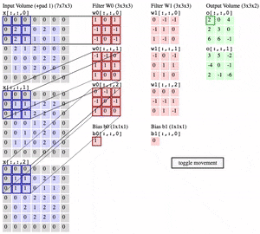
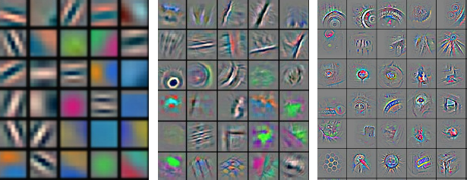
CNN Kernels

Slide 29
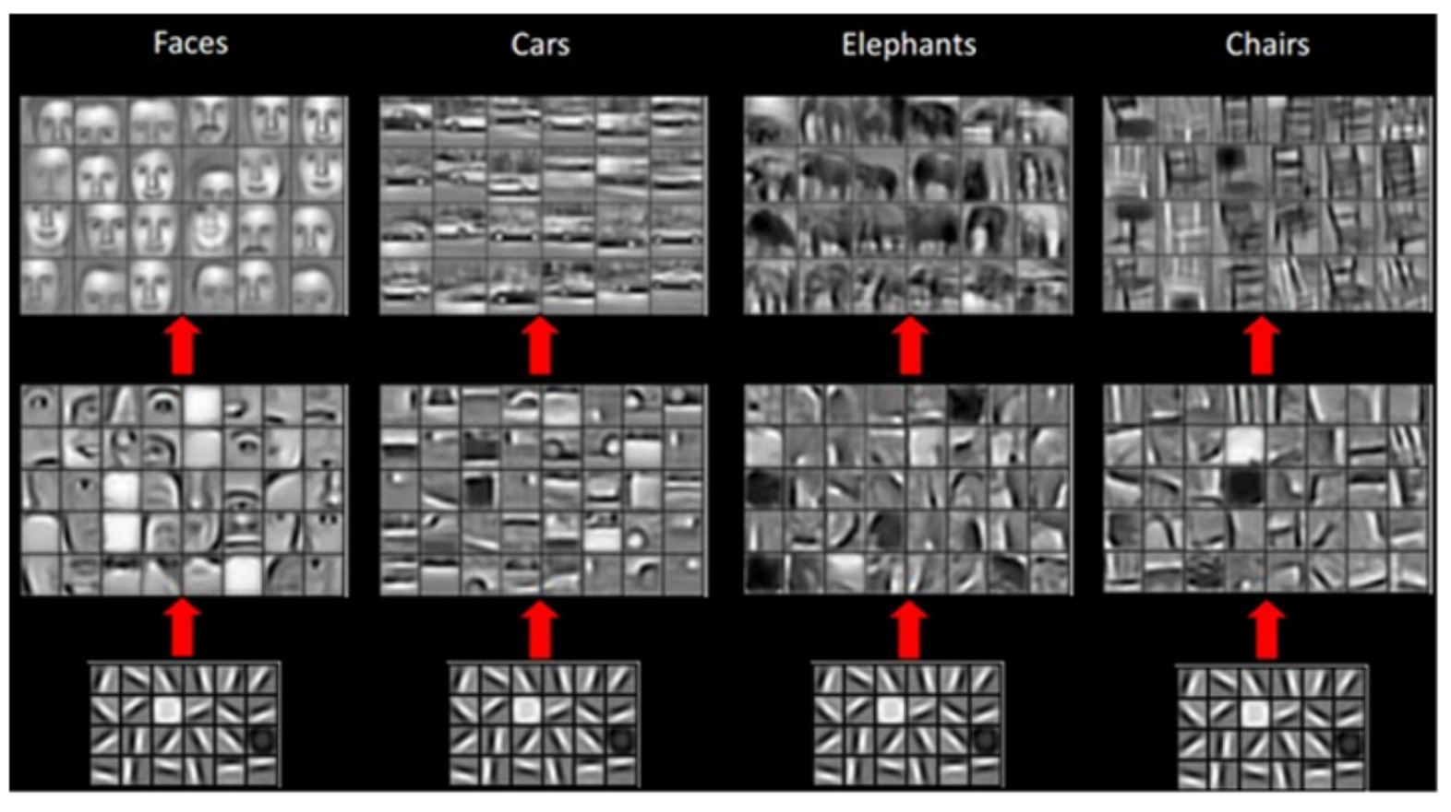
CNN Feature Learning

Slide 30
Further Reading
Frequency-domain filtering:
Homomorphic Filter
Butterworth Filter
Feature extraction:
Gabor Filter

